Slide 1
Customer churn analysis

Slide 2
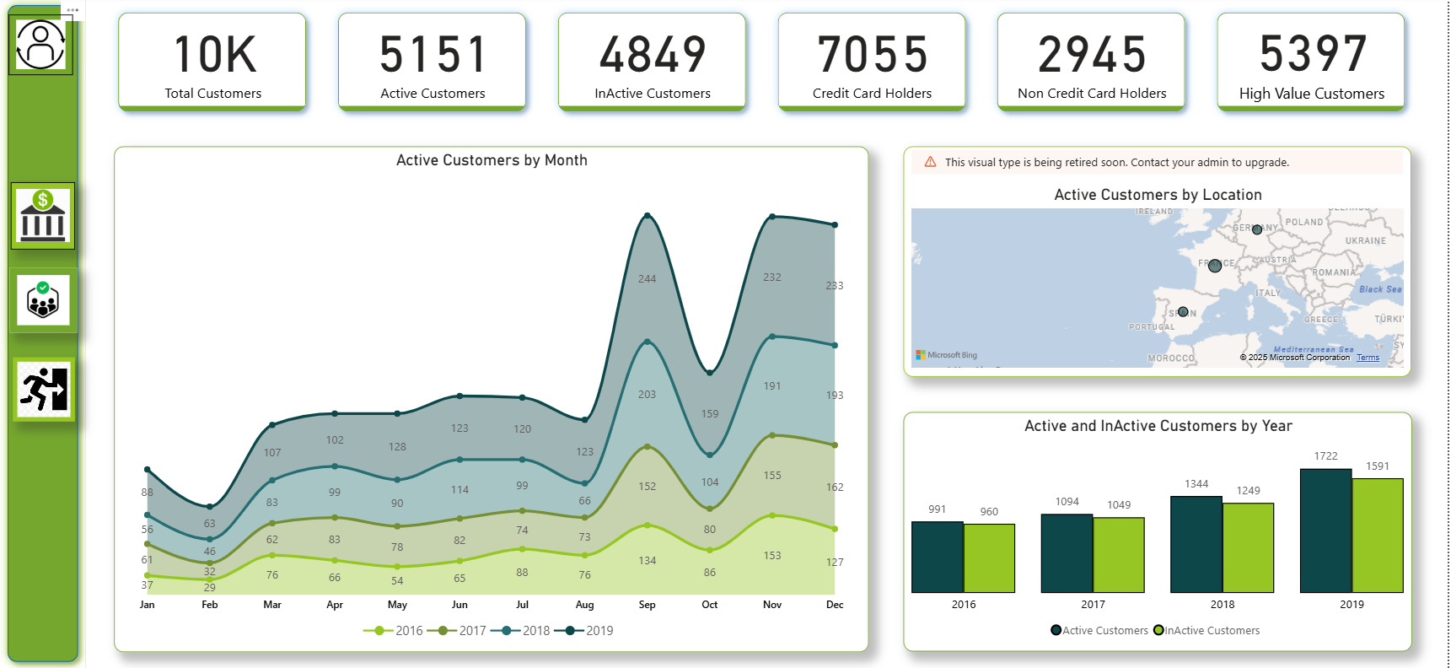
Customers

Slide 3
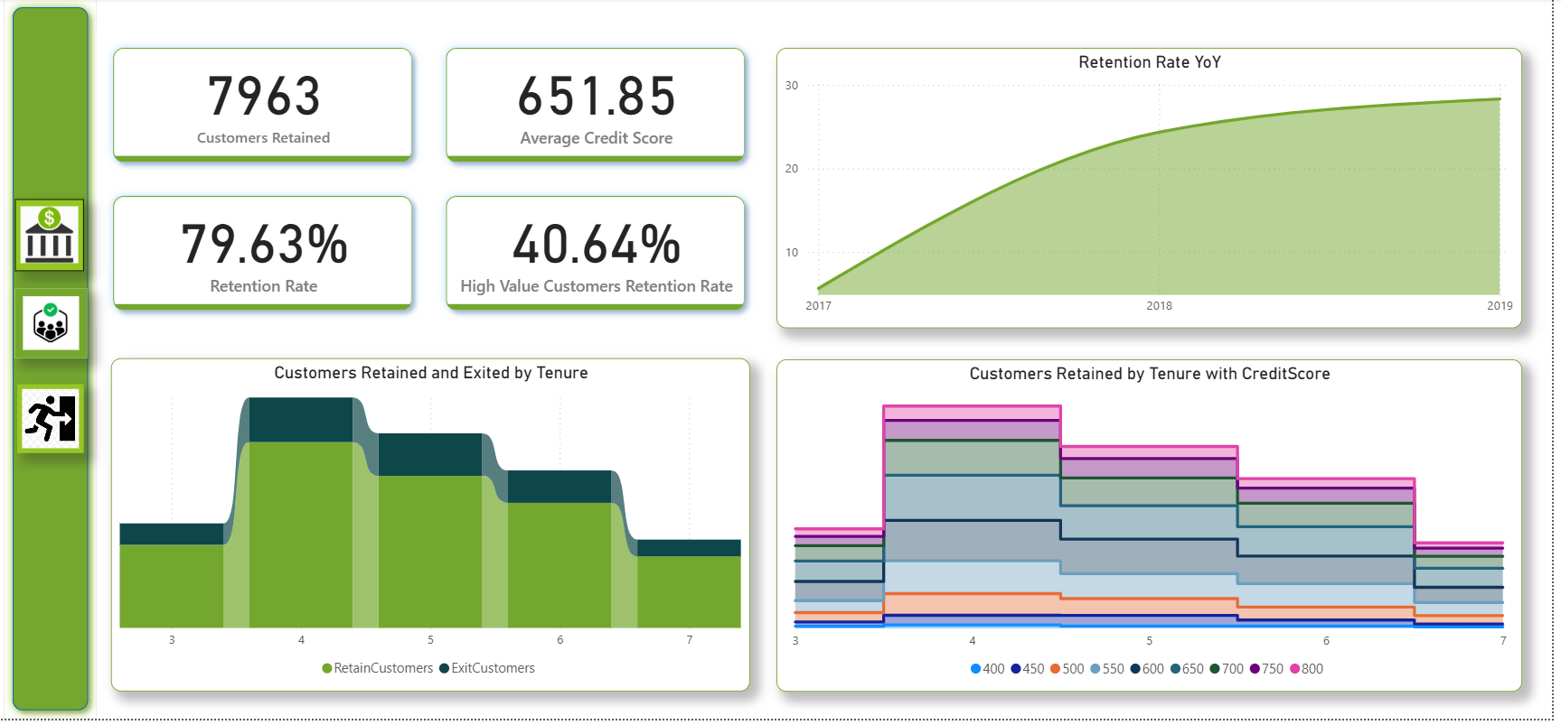
Retained Customers

Slide 4
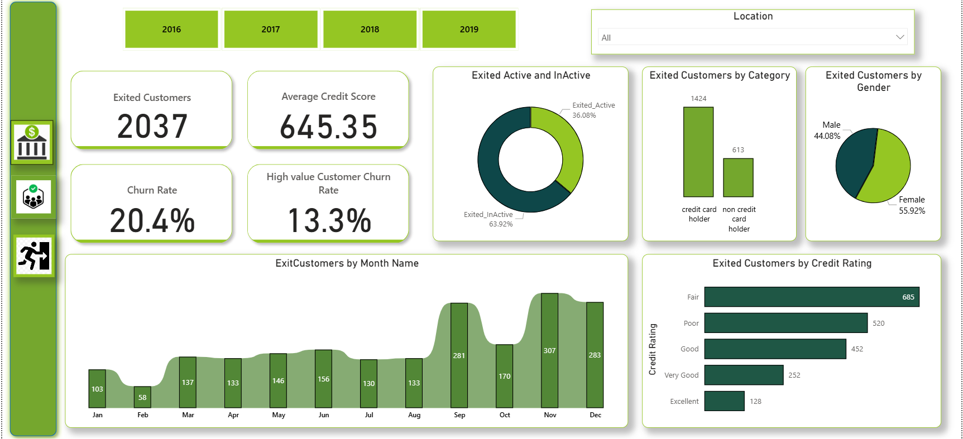
Exited Customers

Slide 5
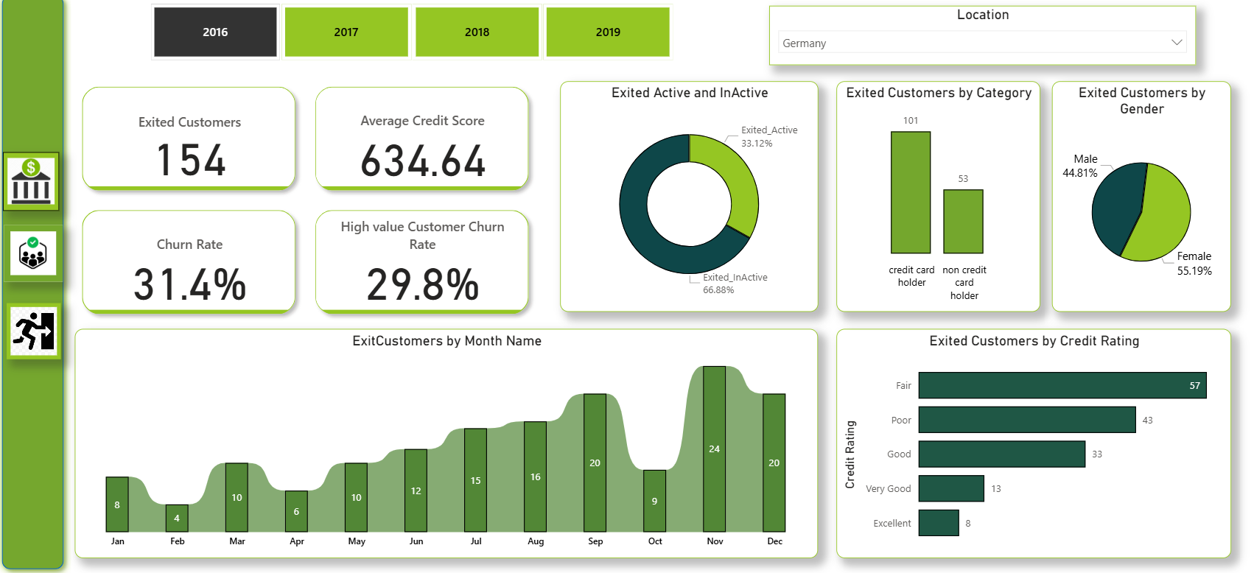
Exited Customers in Germany -2016

